Slide 1
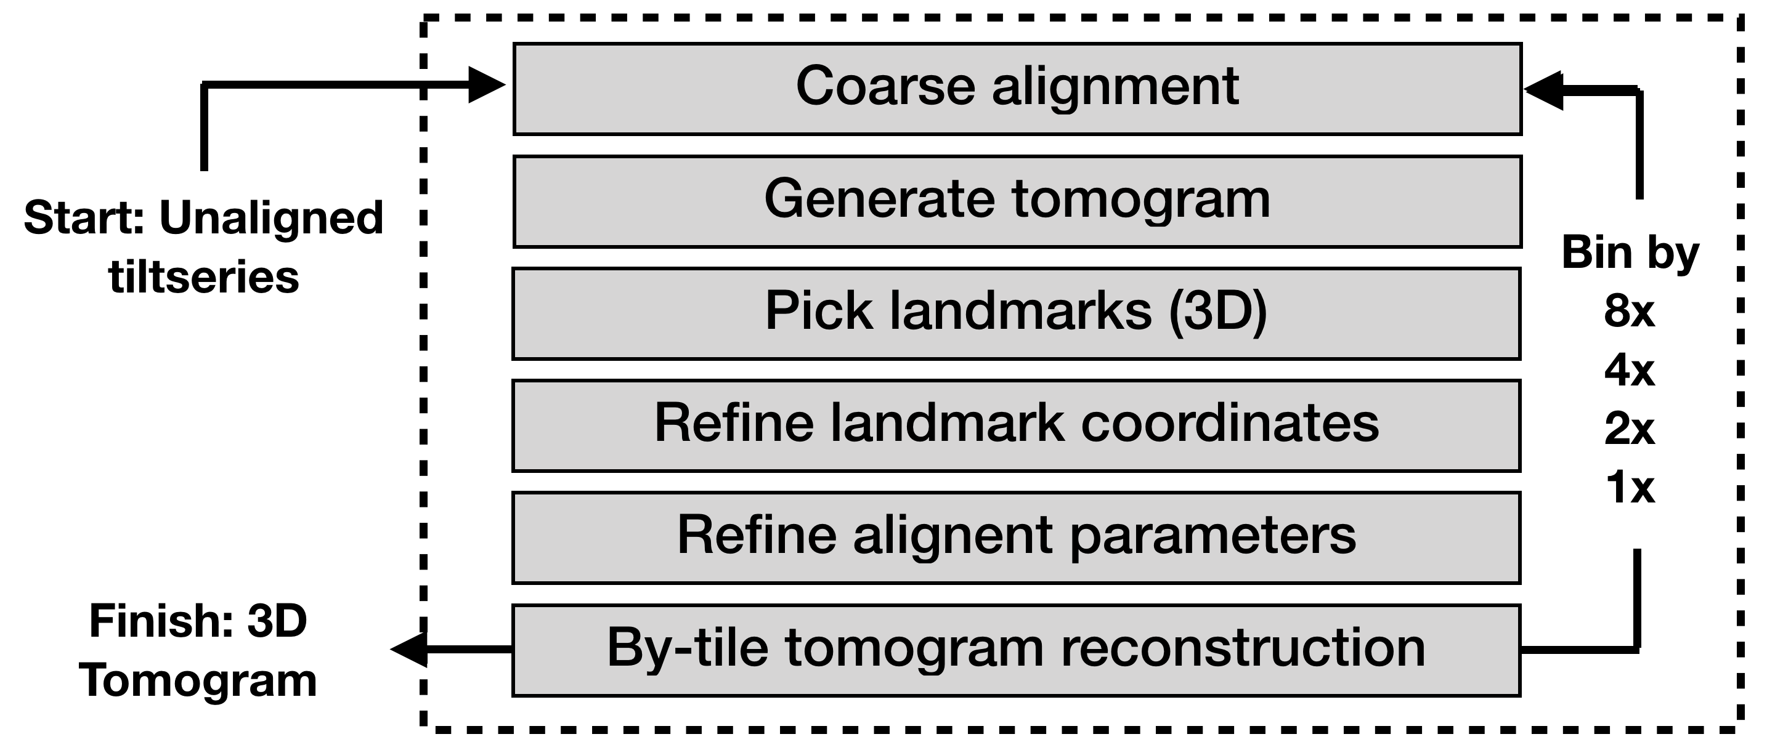
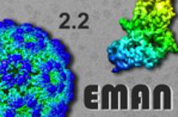
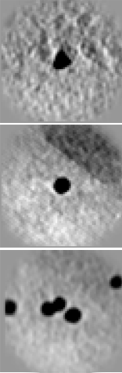
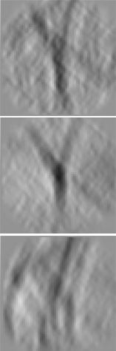
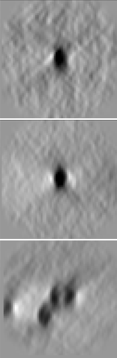
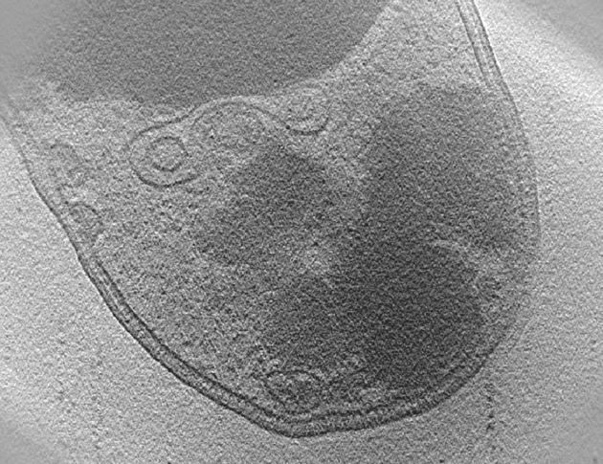
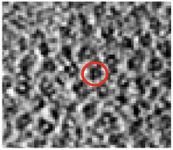
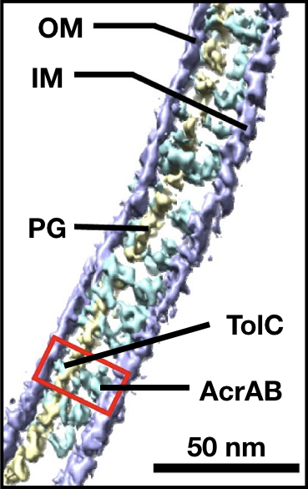
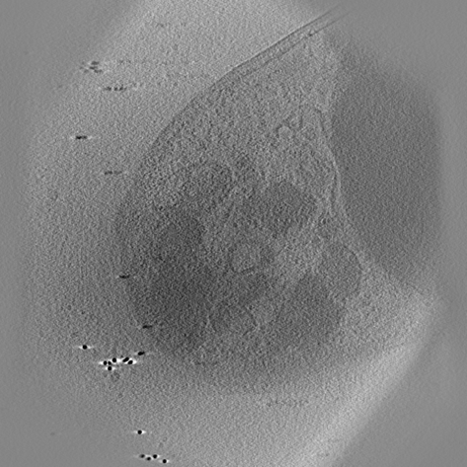
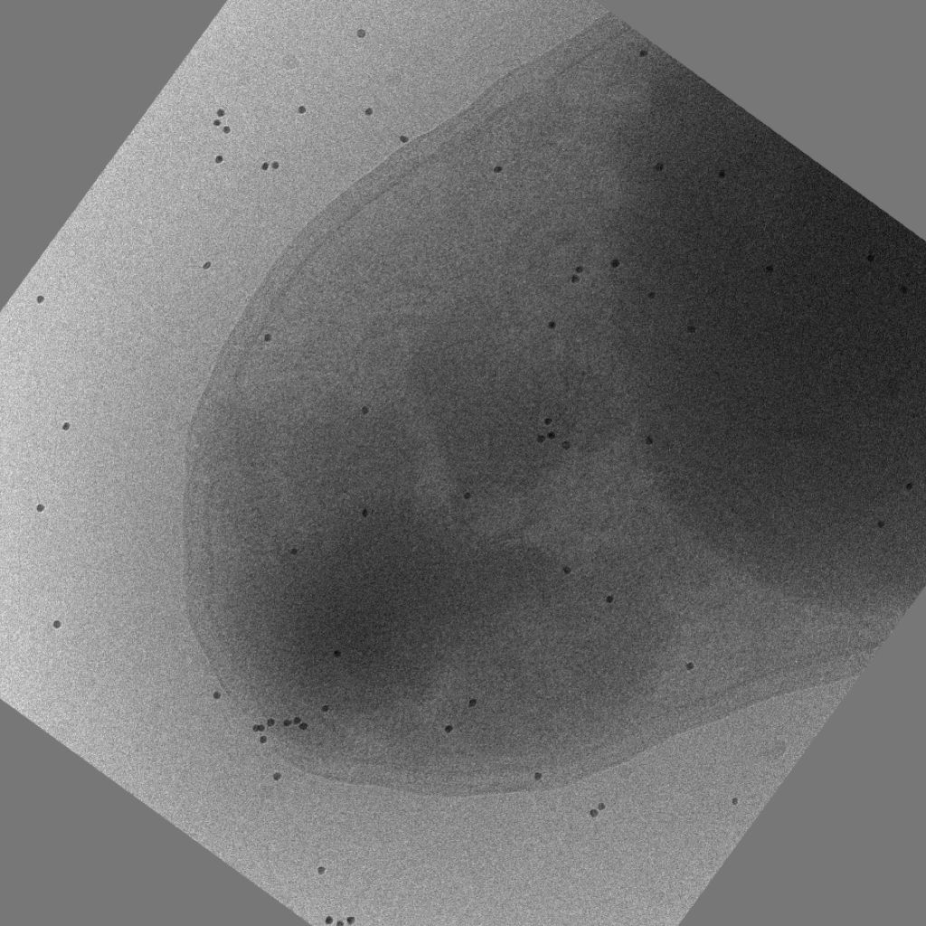
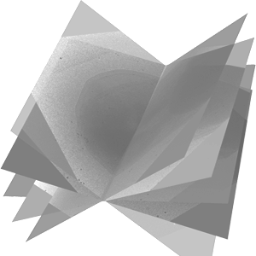
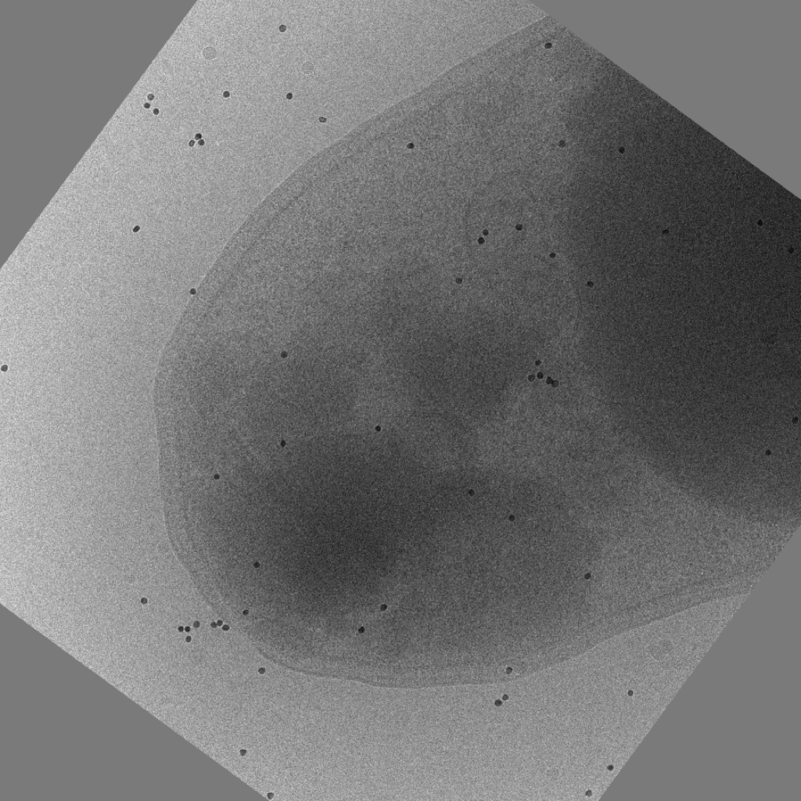
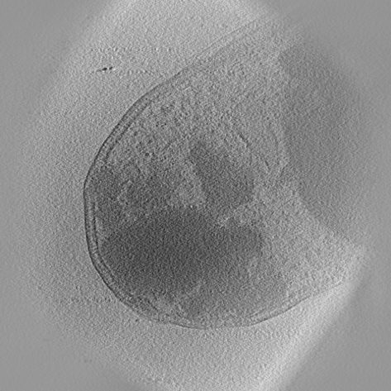
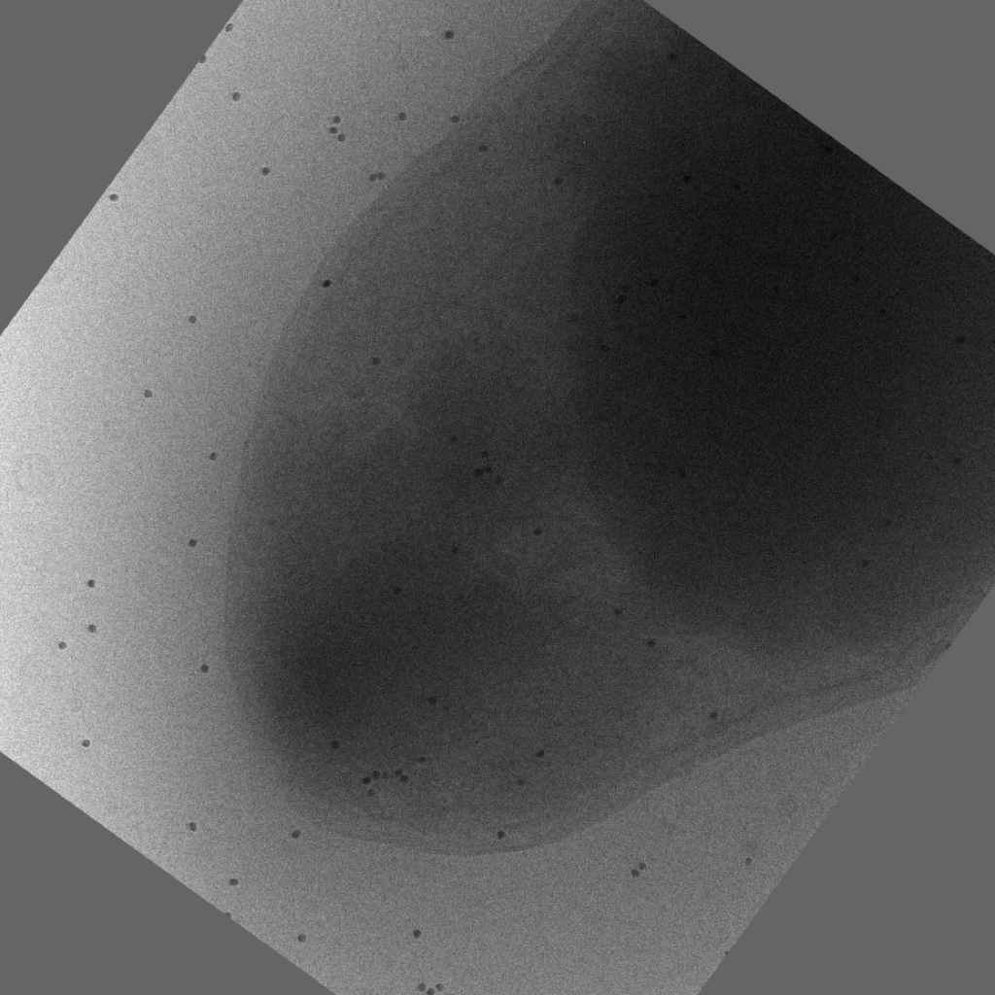

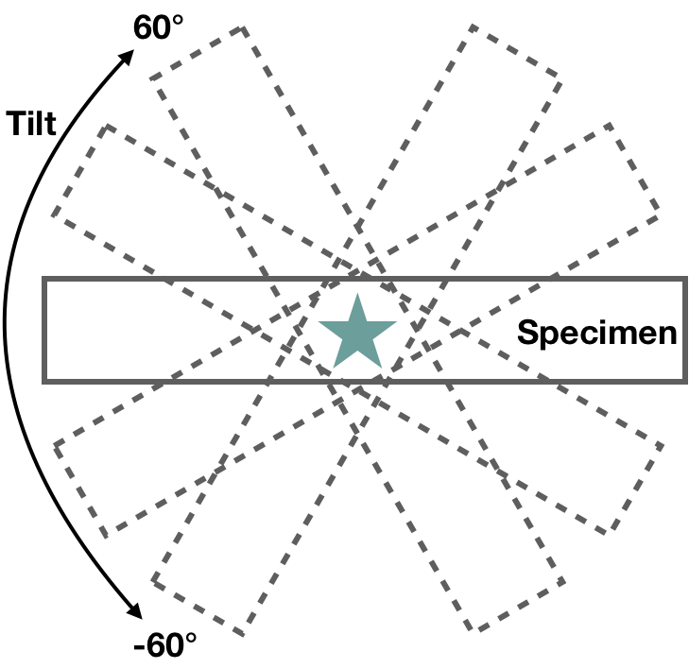
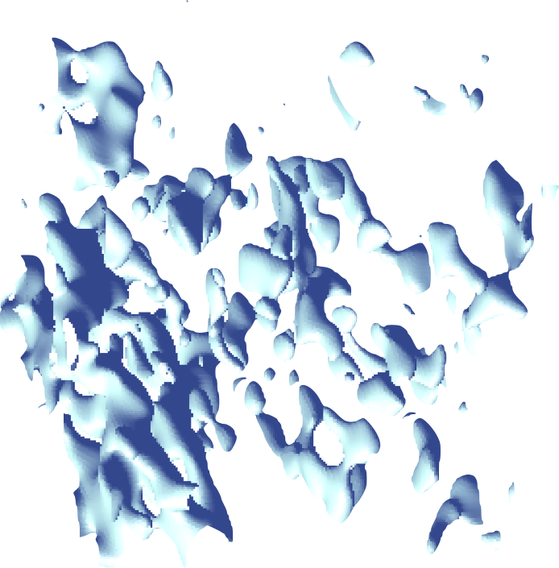
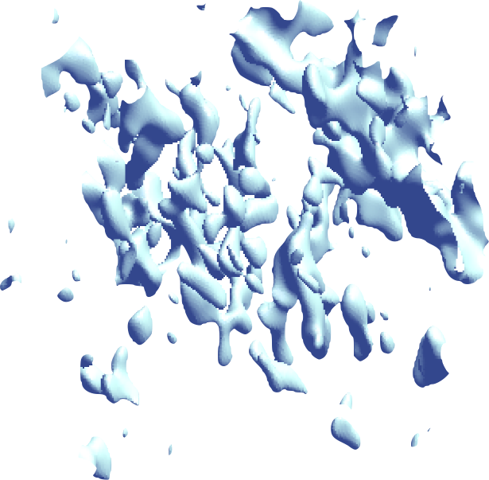
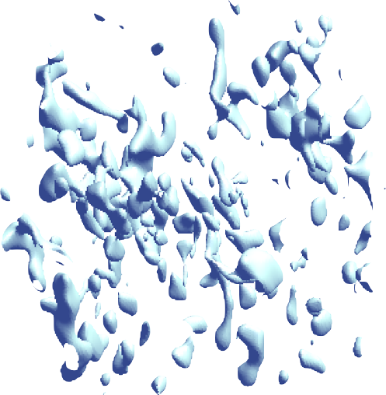
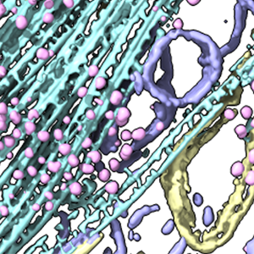
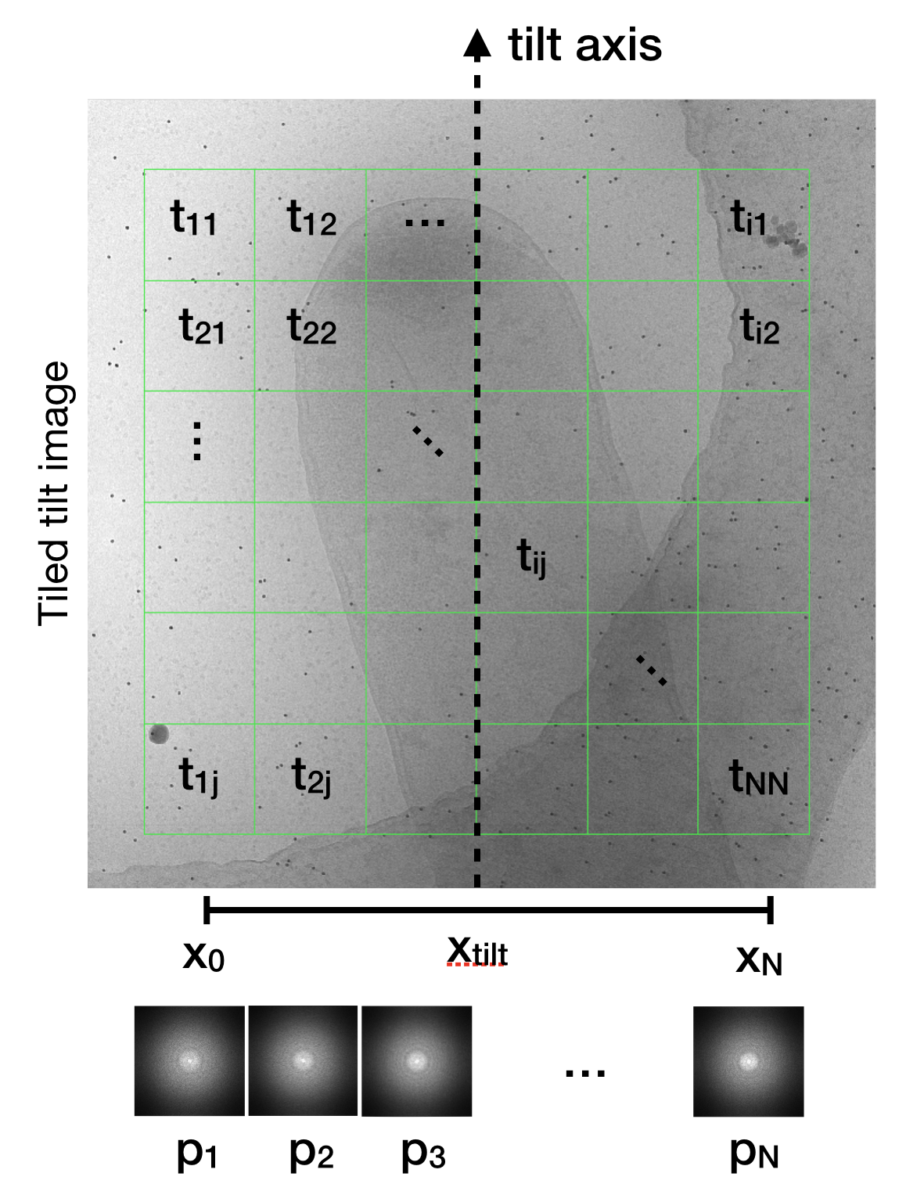
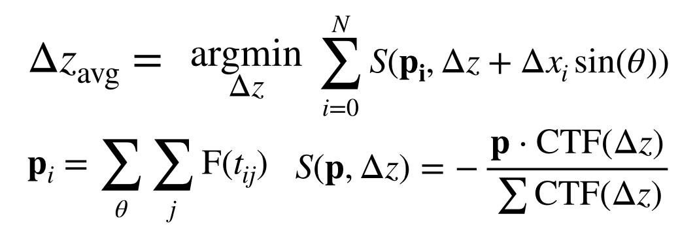
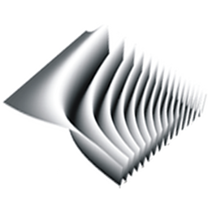
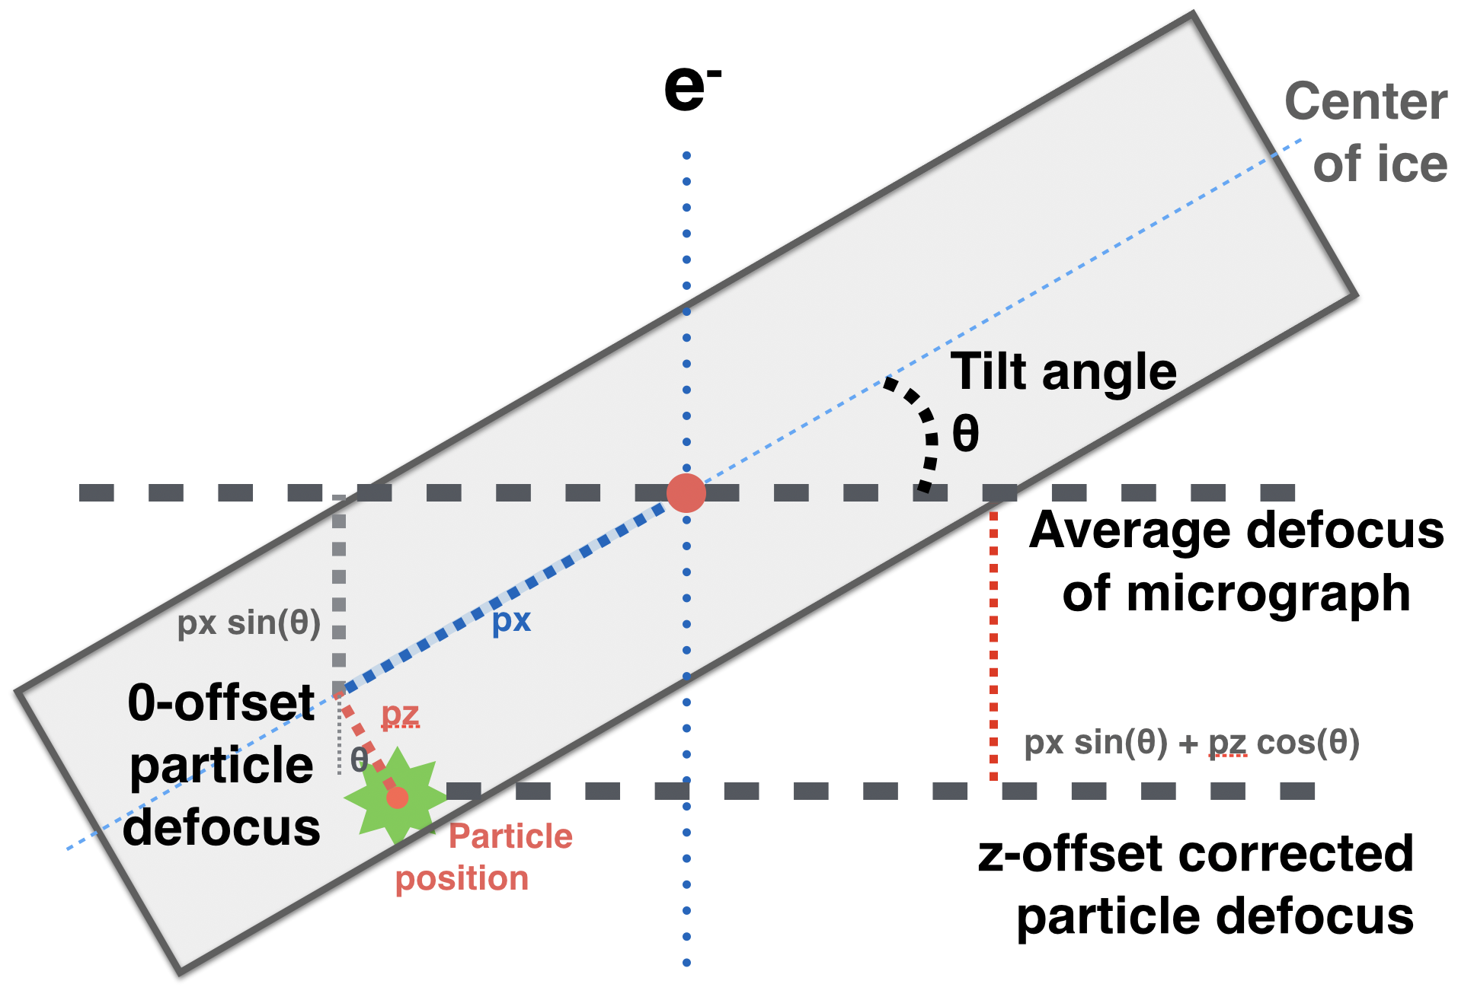
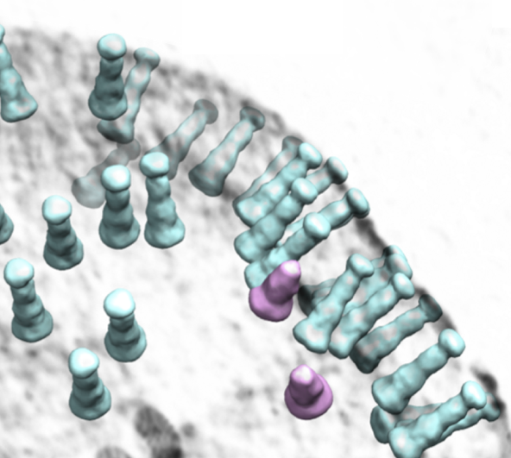
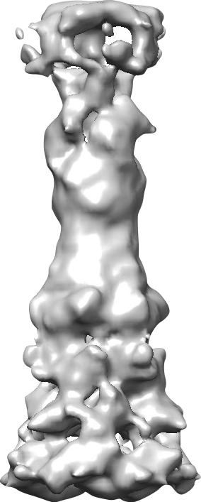
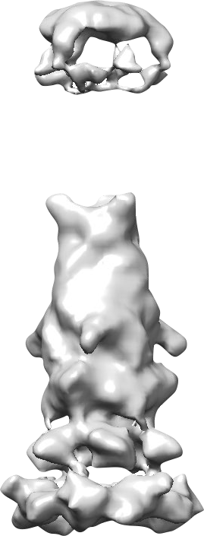
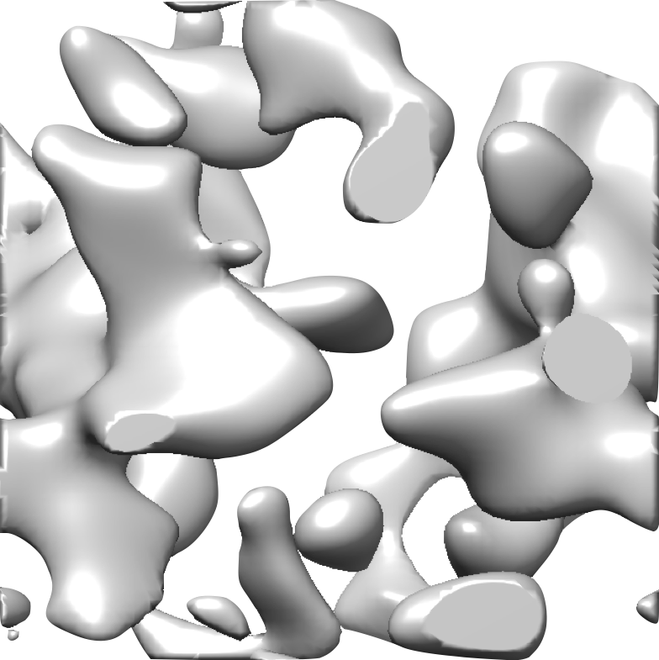
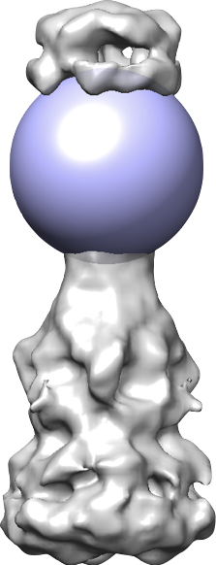
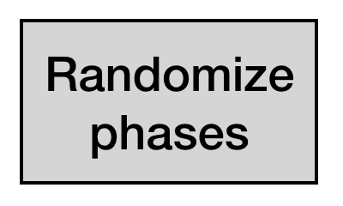
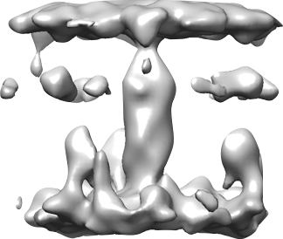
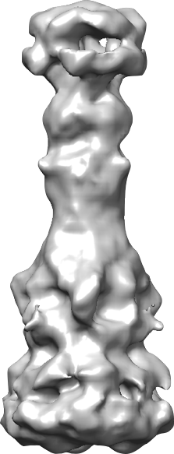
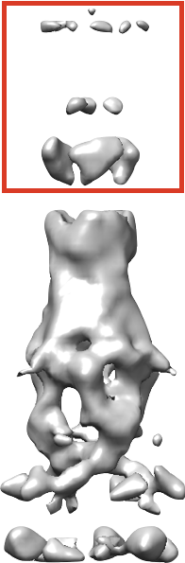
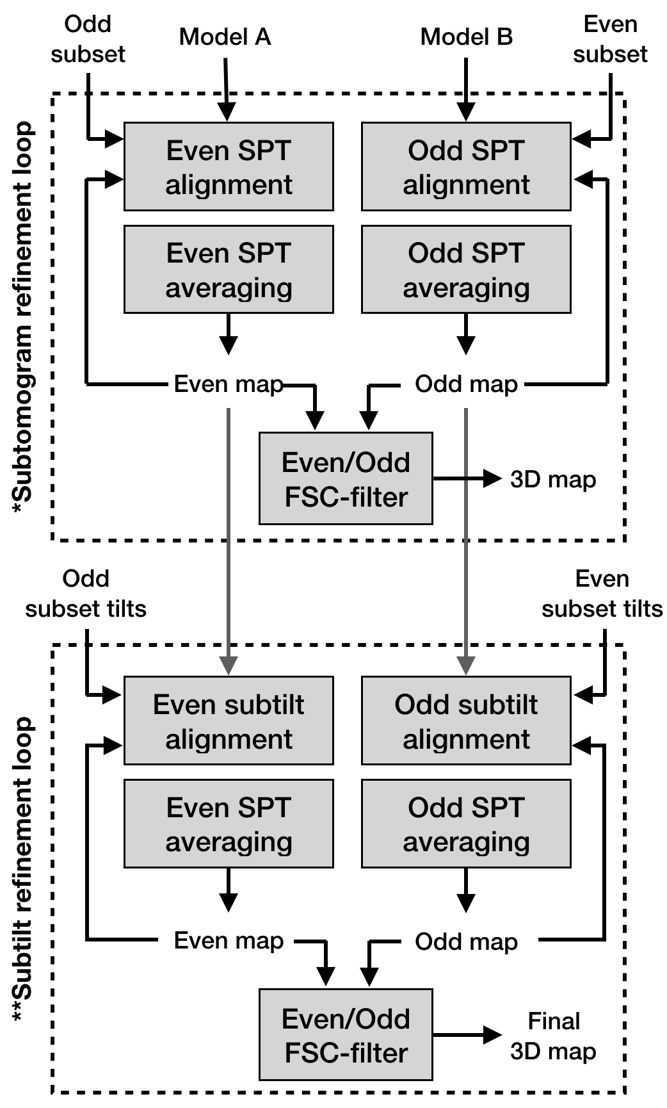
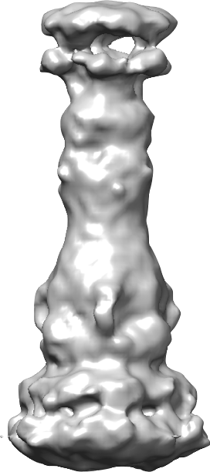
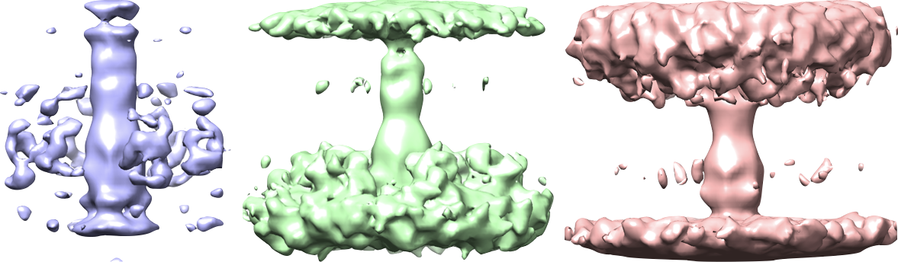
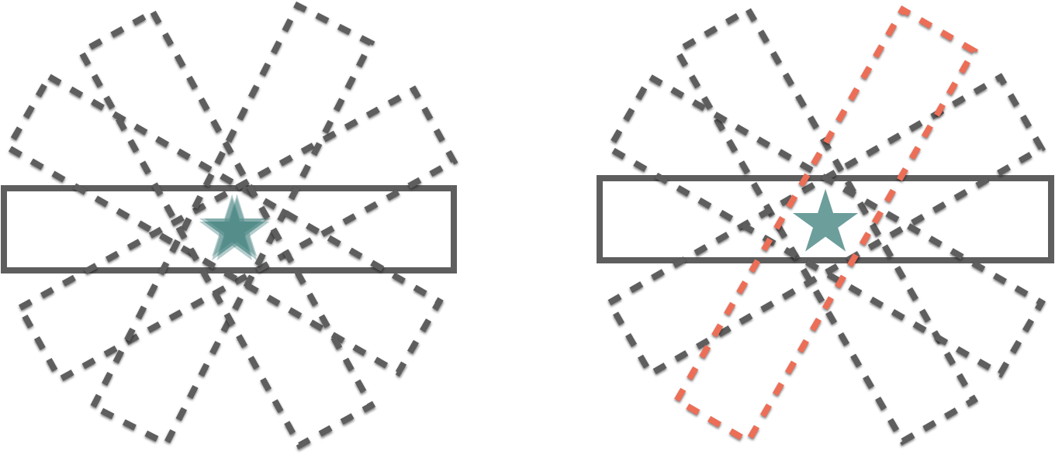
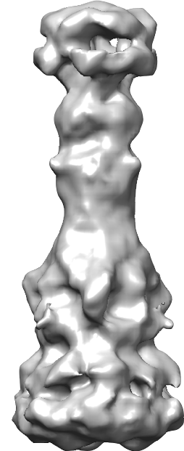
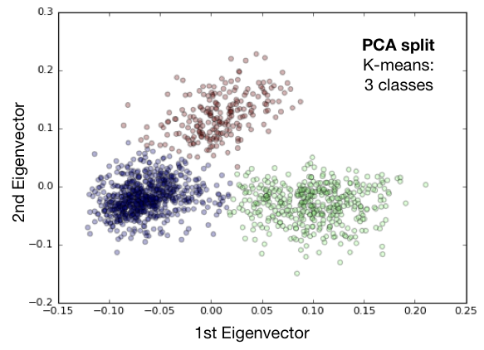
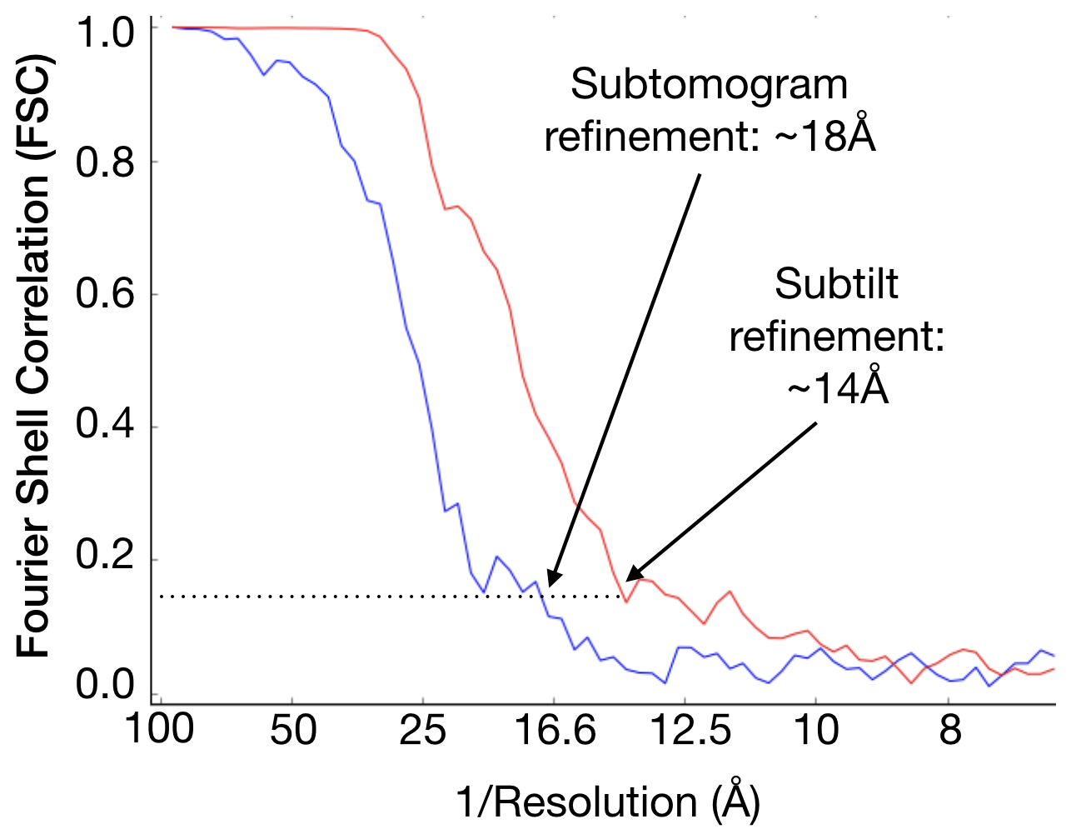
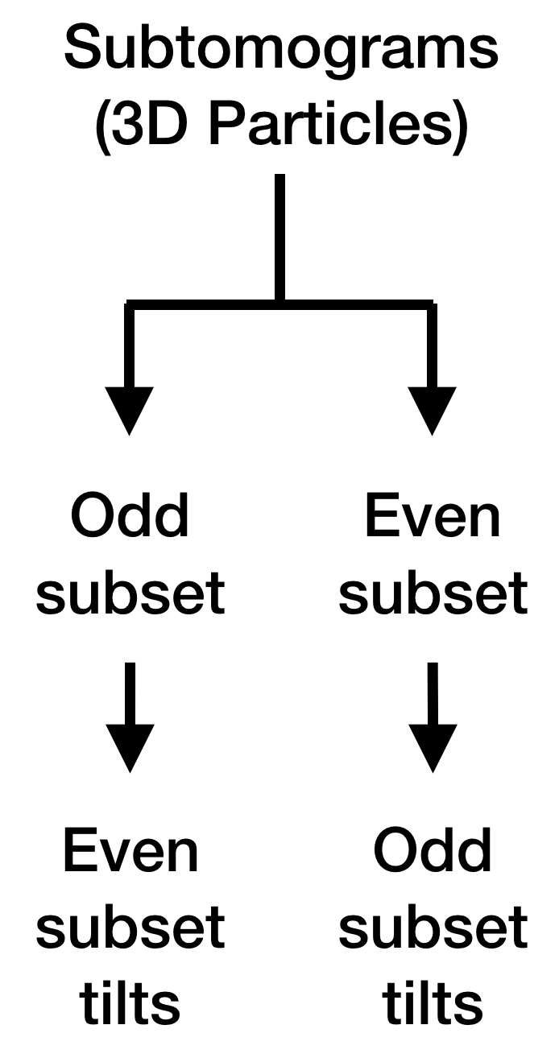


Multidrug efflux pumps (MEP) expel a wide variety of toxic substances across the membrane of bacterial cells. In Gram-negative bacteria, MEP form tripartite complexes spanning the cellular envelope; however,
the in situ structure and assembly mechanism of many such
pumps remain unknown. Using cryo-electron tomography
(cryoET) and subtomogram averaging, we have solved
the first in situ structure of the AcrAB-TolC tripartite
complex and the AcrAB bipartite complex at
better than 2nm resolution. Here we discuss
the computational workflow in EMAN2
used to obtain these two structural states
and how these structures can be
mapped back to the cell, facilitating
state-specific localization in situ. In
addition to demonstrating the
current state of the art in cellular
subtomogram averaging, our
findings also uncover the
assembly mechanism of this
tripartite MEP in living
bacterial cells, ultimately
providing a basis for the
design of MEP inhibitors.
Abstract
xx
Landmarks
Before
After
X-Y
X-Z
X-Z
3
EMAN2 facilitates automated 3D tomogram reconstruction
via the series of algorithmic steps described in the workflow
above. Depending on the quality of the tilt series data, typical alignment errors range from 0 to ~4 pixels depending on the quality of the data, and the time required to align full sampling 8k x 8k data
is ~10 minutes on 12 CPU threads.
Subtomogram
boxing & cellular
annotation
Top views
2
CryoET is an
imaging technique in which
tilted images of a vitrified specimen
are recorded in an electron microscope and reconstructed in 3D.
-18°
3D
reconstruction
E-coli cell
0°
3D particles
A tilt series is a collection
of micrographs recorded
over a range of angles –
usually from -60° to 60° in
increments of ~2°.
40°
Automated 3D
Reconstruction
Side views
Data Acquisition
3D tomograms can be automatically segmented using an
adversarial-CNN approach. Individual particles can also
be extracted for further processing. Next we correct for
microscope distortions on an individual particle basis
using each particle’s location and geometric info from
our automated 3D reconstruction procedure.
1
State specific localization of AcrAB-TolC in E. Coli using subtomogram averaging
Bell JM¹, Chem M¹, Shi X¹², Yu Z², Wang H², Forrester I¹, Villarreal H¹, Jakana J¹, Du D^{3,4}, Luisi B⁴, Wang Z¹, Ludtke SJ¹
¹Baylor College of Medicine, ²Xuzhou Medical University , ³Shanghai Tech University, ⁴University of Cambridge
Feature Extraction
Contrast transfer function
(CTF) correction
OM
Heterogeneity Analysis
PG
Subtomogram Averaging
SGD
Focused
classification
We utilize a stochastic gradient
descent approach to generate de novo,
reference-free initial models, which are
used to seed multiple iterations of 3D
refinement. “Subtilt” (per-particle per-tilt)
decomposition methods are then used to
refine individual particles to obtain higher resolutions than previously possible.
Initial
model
4
IM
800 Particles
516 Particles
To analyze structural variability among
particles, we classify particles in a PCA
subspace and reconstruct each cluster.
We can further subdivide particle data
using focused techniques to label particles
according to the contents of a 3D mask.
3D SPT average
Acknowledgements
Threshold
Subtilt
refinement
This research is supported by a Center Gulf Coast
Consortium (GCC), Houston Area Molecular
Biophysics Program (HAMBP) training fellowship from
the Keck Center (T32 GM008280), the National Institute
General Medical Sciences (NIGMS, R01GM080139), and the
Welch Foundation (Q-1967-20180324).
Subtilt
average
5

